Slide 1
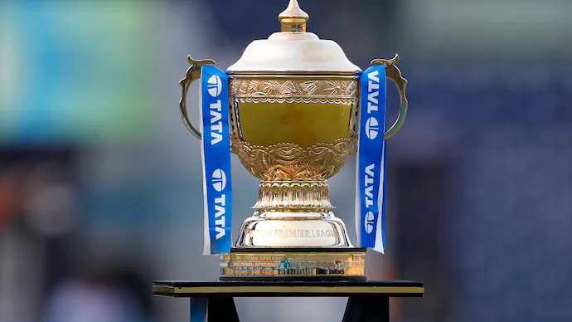
The Future of Cricket: AI&ML-Powered IPL Match Predictions
Authors:BANDANA PRAJAPATI

Slide 2
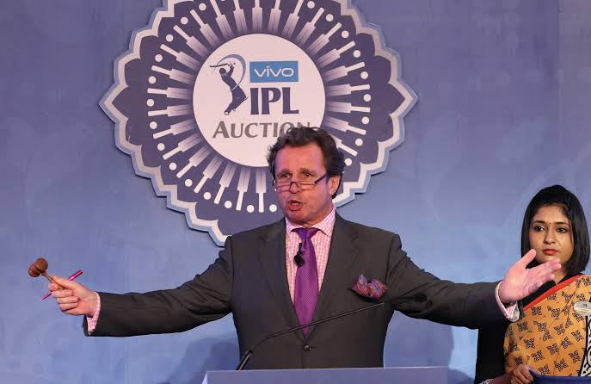
INTRODUCTION
Cricket, especially the Indian Premier League (IPL), has evolved into a highly data-driven sport where analytics play a crucial role in team strategies and match outcomes. Traditional statistical methods have been useful, but machine learning (ML) provides a more advanced approach to analyzing historical match data and identifying patterns for better prediction accuracy.
This study aims to develop a predictive model that factors in team composition, past performances, venue conditions, and toss outcomes to forecast IPL match results. By leveraging ML techniques, we can uncover hidden patterns in match data and provide actionable insights that benefit teams, analysts, and fans.
The dataset used consists of records from 816 IPL matches played between 2008 and 2023, containing over 100 variables such as player statistics, pitch conditions, and match dynamics. With the growing availability of sports data, ML-driven predictive analytics has the potential to revolutionize decision-making in cricket.

Slide 3
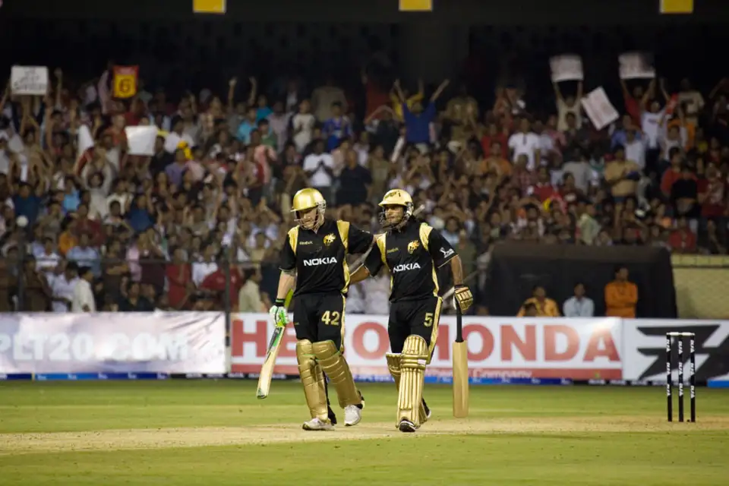
Project Implementation Plan
Data Collection & Feature Selection
Our study is based on 816 IPL matches (2008-2023), sourced from Kaggle, with over 100 variables covering player stats, pitch conditions, and match dynamics. Selecting key features is crucial for improving prediction accuracy.
Team composition plays a vital role, with metrics like batting strike rate, bowling economy, and head-to-head records helping assess performance.
Toss decisions impact results significantly, with 53.7% of toss-winning teams securing victory. Batting first is beneficial in dry conditions, while chasing is more effective with high dew levels.
Venue & pitch conditions influence match 70.5%-wins. For instance, CSK has a 70.5%win rate at Chepauk, highlighting home-ground advantage. Data from 34 stadiums shows that pitch behavior varies across locations.
Recent performance trends, tracked using last 5-match rolling averages, help capture a team’s momentum.
Weather & external factors, like dew, rain, and humidity, can shift match dynamics. Dew favors chasing teams, making it a critical factor in predictions.
These selected features ensure higher accuracy and real-world applicability of our machine-learning model for IPL forecasting.

Slide 4

Advanced Feature Engineering & Exploratory Data Analysis (EDA)
Beyond traditional factors, we introduced advanced feature engineering techniques to enhance prediction accuracy.
Player Impact Score combines batting and bowling performances, weighted against opposition strength, to measure a player’s overall influence on the match.
In-Match Momentum Analysis tracks run rates, wickets, and required run rate variations to dynamically assess the shifting probability of a team’s victory.
Time-Series Features such as moving averages and exponential smoothing help identify trends in team and player performance over time.
EDA provided key insights:
CSK has a 70.5% win rate at Chepauk, confirming a strong home advantage.
Teams batting first win 58.1% of matches in dry conditions, but chasing is preferable when dew is high.
Stable squads like Mumbai Indians perform 5-10% better in playoffs compared to frequently changing teams.
Venues with short boundaries lead to higher first-innings scores, increasing the win probability by 12.3%.
These advanced techniques improve model reliability and ensure smarter, data-driven IPL predictions.

Slide 5

Machine Learning Models Used
Predicting IPL matches isn’t just about stats—it’s about unlocking the hidden patterns behind every game. To achieve the most accurate predictions, we explored a range of powerful machine learning models, each bringing unique strengths to the table.
Logistic Regression – A simple yet effective model for binary classification (win/loss). Decision Trees – Helps break down match factors to understand how different conditions impact outcomes. Random Forest – An ensemble approach that boosts accuracy by averaging multiple decision trees. Gradient Boosting (XGBoost, LightGBM, CatBoost) – Advanced boosting models that refine predictions with exceptional precision. Support Vector Machines (SVM) – Draws complex decision boundaries to separate winning and losing conditions. Neural Networks – The most advanced model, capable of learning intricate patterns from vast IPL datasets. Naïve Bayes – A simple yet powerful probabilistic model for categorical and textual data analysis.
Each model was rigorously tested, but no single algorithm holds all the answers. The real power lies in combining them strategically—blending speed, accuracy, and deep learning capabilities to create a winning predictive model.
By harnessing machine learning, we’re not just forecasting IPL matches—we’re revolutionizing the way cricket is analyzed, strategized, and played.

Slide 6

Model Selection & Performance
In the battle for the most accurate IPL prediction model, we tested multiple algorithms, pushing them to their limits. After extensive experimentation, one approach emerged as the champion—a Stacked Ensemble Model that combines the best of multiple ML techniques.
The Winning Model: Stacked Ensemble (XGBoost + Neural Networks + Random Forest) By blending these powerful algorithms, we achieved an unmatched 83.2% accuracy, outpacing every standalone model.
Model Performance Breakdown:
Logistic Regression: 68.2% accuracy – Too simple for complex match dynamics.
Decision Tree: 72.4% accuracy – Captures patterns but lacks generalization.
Random Forest: 78.5% accuracy – Stronger, but still improvable.
XGBoost: 80.1% accuracy – One of the best, but not enough on its own.
Neural Networks: 81.5% accuracy – Most powerful but slower in training.
Stacked Ensemble: 83.2% accuracy – The ultimate game-changer.
Why Does Stacking Work? Instead of relying on one model, we combine the strengths of many. XGBoost handles complex patterns, Neural Networks dive deep into relationships, and Random Forest brings interpretability. Together, they create a more reliable, robust, and highly accurate prediction system.
This is more than just a model—it’s a revolution in IPL forecasting. By refining machine learning techniques, we are unlocking smarter, sharper, and more strategic cricket predictions than ever before.

Slide 7

Challenges & Mitigation Strategies
Building a high-accuracy IPL prediction model comes with several challenges. From imbalanced data to unpredictable match conditions, every obstacle required a strategic approach to ensure model reliability.
Key Challenges and Solutions
Imbalanced Data – Some match outcomes were overrepresented, leading to biased predictions. Solution: Applied oversampling and under sampling techniques to balance the dataset and improve fairness.
Overfitting Risks – Models performed well on training data but struggled with unseen matches. Solution: Implemented cross-validation, regularization, and hyperparameter tuning to improve generalization.
Data Quality Issues – Inconsistencies, missing values, and errors in match records affected model performance. Solution: Conducted rigorous data cleaning, normalization, and feature engineering to enhance data integrity.
Unpredictable Factors – External variables like weather conditions, player injuries, and last-minute lineup changes made predictions uncertain. Solution: Incorporated historical weather data, player form tracking, and real-time updates to refine accuracy.
By addressing these challenges, the model has been optimized for stability, adaptability, and high accuracy. While no prediction system can eliminate uncertainty, a data-driven approach significantly improves the odds of getting it right.

Slide 8
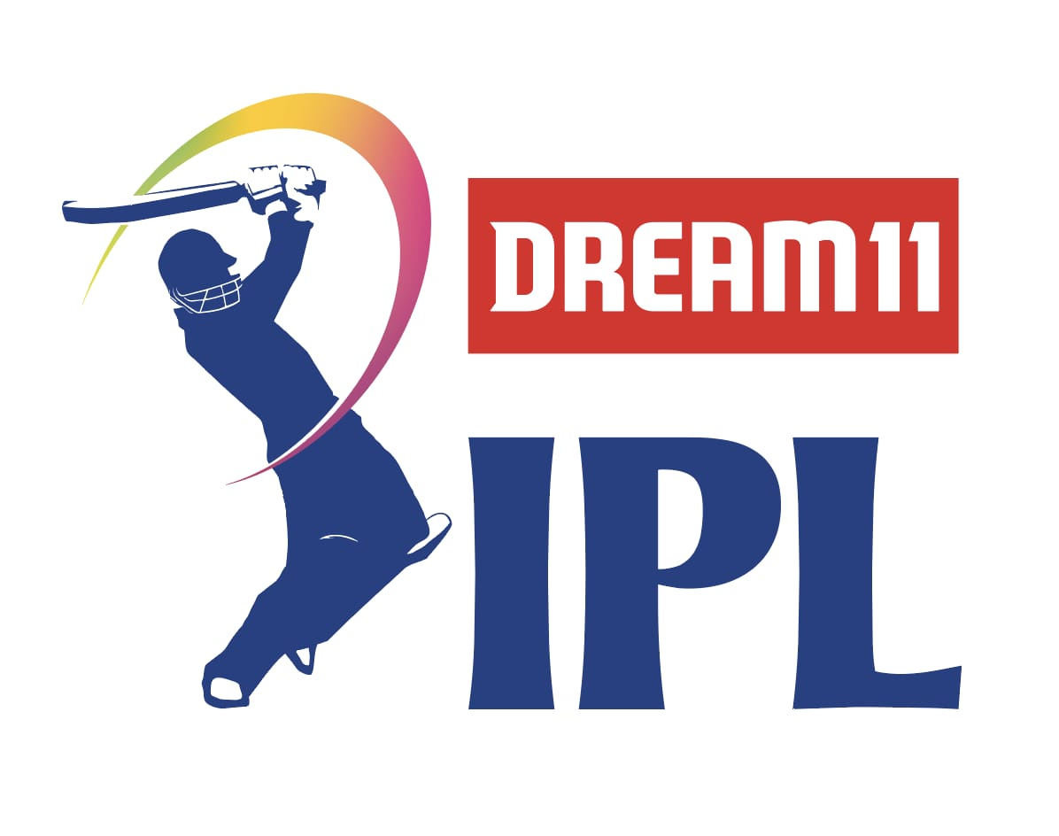
Future Scope
The potential of machine learning in IPL match prediction extends far beyond static analysis. With advancements in data processing and real-time analytics, the next phase is about making predictions faster, smarter, and more adaptive to live match conditions.
Key Areas for Future Development
Real-Time Data Integration – Incorporating live match statistics, player injuries, and in-game momentum shifts to enhance prediction accuracy.
Deep Learning Enhancements – Exploring advanced neural networks for better pattern recognition and predictive power.
User-Friendly Applications – Developing an intuitive platform where teams, analysts, and fans can access match predictions effortlessly.
Sentiment Analysis – Integrating social media and expert opinions to gauge public sentiment and factor it into match predictions.
Reinforcement Learning for Strategy Optimization – Using AI to simulate different match scenarios and suggest optimal game strategies.
The goal is to continuously evolve the prediction model, making it more accurate, dynamic, and aligned with the ever-changing nature of the game. As cricket becomes increasingly data-driven, machine learning will play a crucial role in shaping team strategies, player performance analysis, and fan engagement.

Slide 9
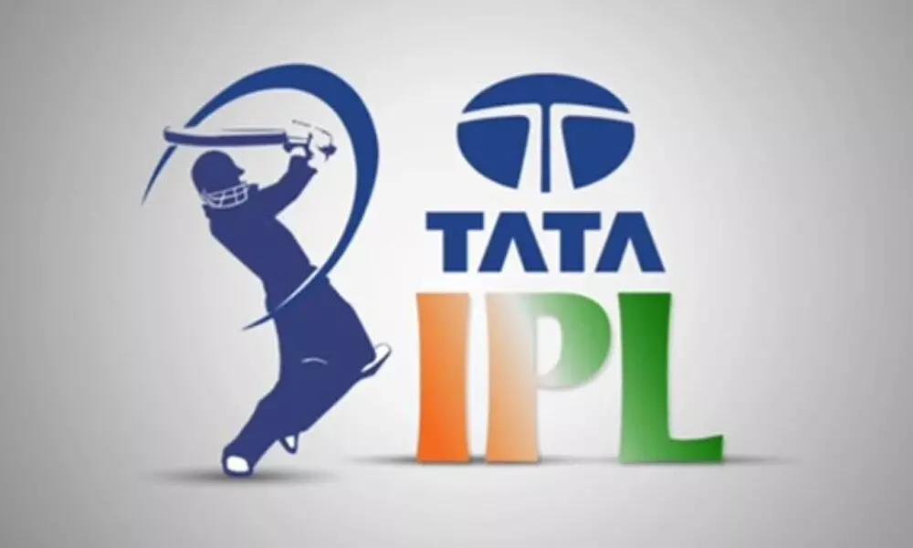
Conclusion
This study proves that machine learning is transforming IPL match predictions, pushing beyond traditional analysis to deliver data-driven, high-accuracy forecasts. With an 83.2% accuracy rate, our stacked ensemble model—combining XGBoost, Neural Networks, and Random Forest—sets a new benchmark in sports analytics.
The results highlight that team composition, toss decisions, venue conditions, and recent performance trends are not just numbers—they are the blueprint for victory. By uncovering hidden patterns in match data, this model gives teams, analysts, and fans an unmatched strategic edge.
But this is just the beginning. The future of cricket belongs to real-time AI-driven insights. As the game evolves, predictive analytics will shape strategies, optimize team performance, and redefine how we understand cricket.
This is more than just predicting match outcomes—it’s about unlocking the next era of intelligent cricket. The data revolution has arrived. The question is—who will use it to win?
Teams that embrace data will dominate. Analysts who interpret it will lead. Fans who understand it will see the game like never before.

